Slide 1
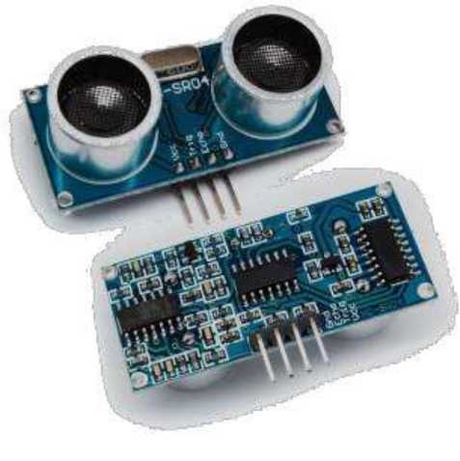
Ultrasonic
Sensor

Slide 2
What is an Ultrasonic Sensor ?
• The Ultrasonic Sensor is a Transceiver Module (Transmitter + Receiver).
• It transmits High Frequency Ultrasonic Waves of frequency greater than 20 KHz.
• Intercepts the waves reflected by an obstacle.
• Electrical Signals ^ Ultrasonic Signals ^ Electrical Signals

Slide 3
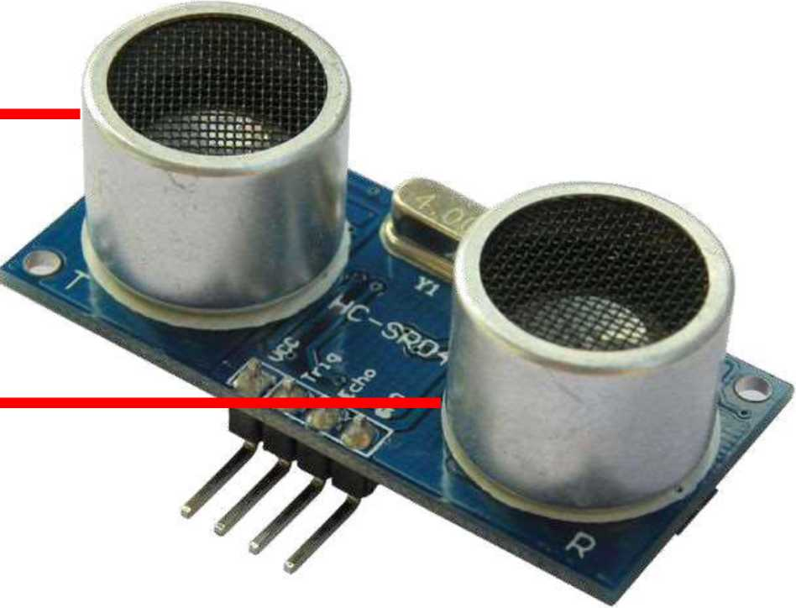
HC-SR04
Transmitter ◄
Receiver ◄

Slide 4
HC-SR04 (Specifications)
_{S}
It provides2 - 400 cm non-contact measurement function.
_{S}
Operating Voltage : 5V
_{S}
Working Frequency : 40 KHz
_{S}
Trigger Input Signal : 10ps TTL pulse

Slide 5
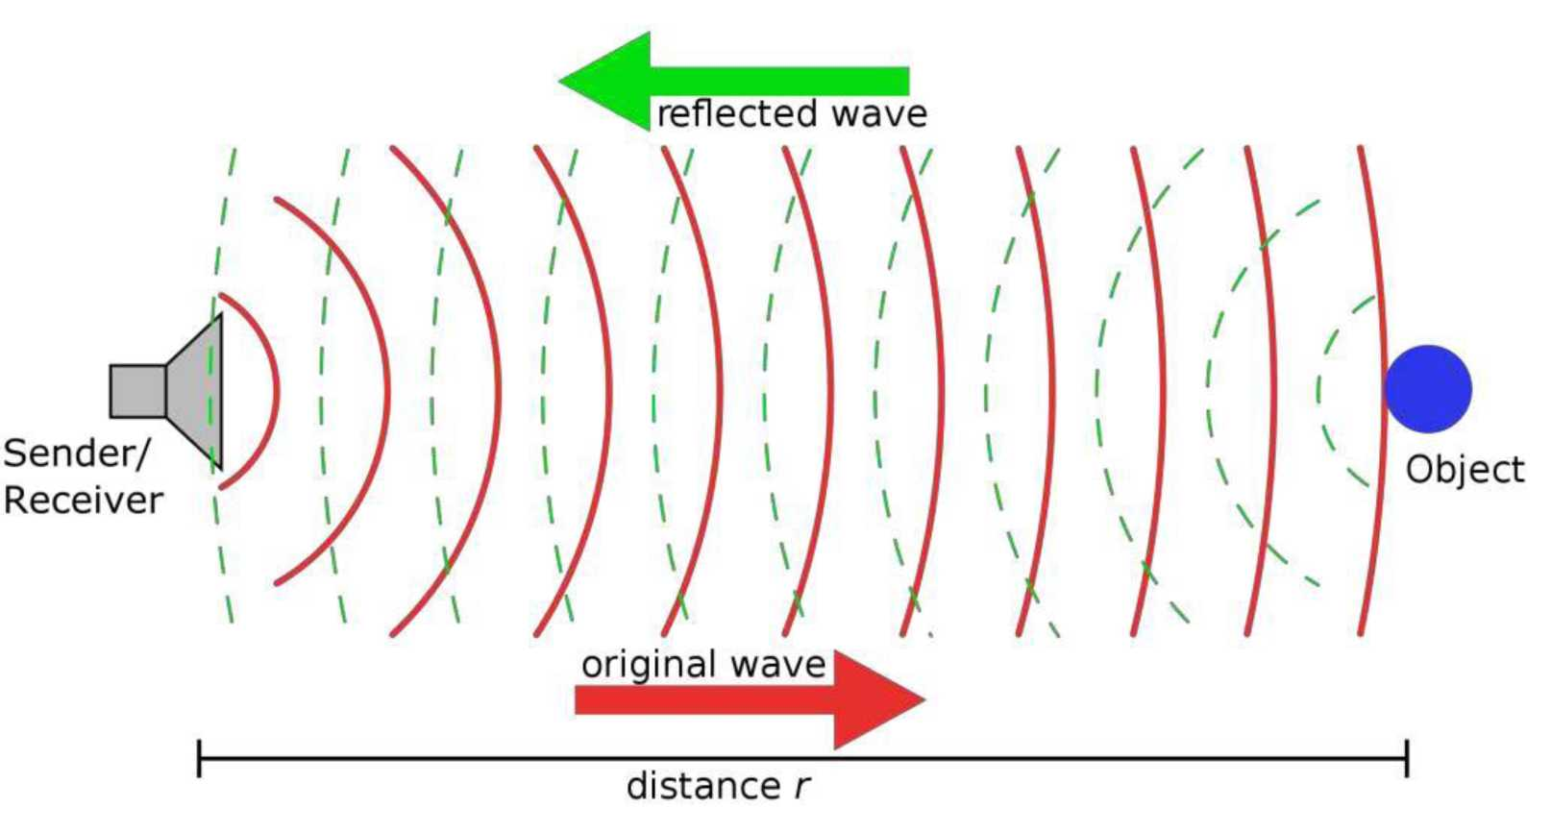
Working Principle

Slide 6
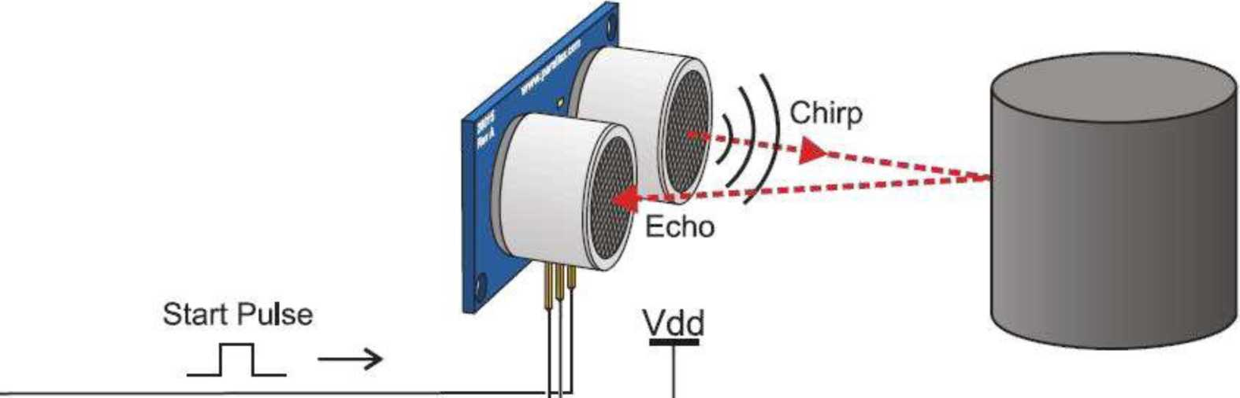
Working Principle
<— J L
Echo Time Pulse —
Vss

Slide 7
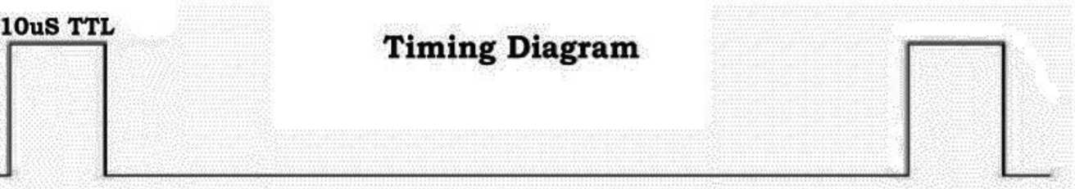
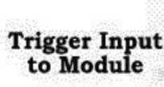
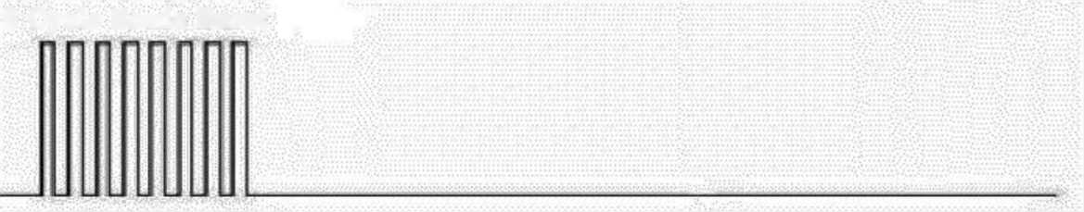
Working Principle
8 Cycle Sonic Burst
Sonic Burst From Module
Input TTL Lever Signal with a Range in Proportion
Echo Pulse Output to User Timing Circuit

Slide 8
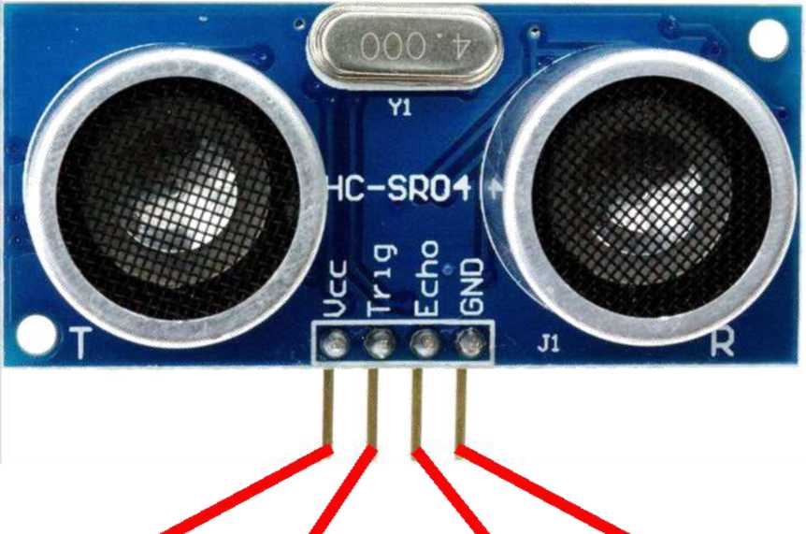
Pin Configuration
TRIGGER : ECHO :
Connect to +5 V pin on Arduino
Connect to GND pin on Arduino
connect to connect to
Digital Pin 4 Digital Pin 2

Slide 9
Applications

Slide 10
Ultrasonic sensors can measure the following parameters, without even getting in contact with the medium which is to be measured :
• Distance
• Level
• Presence
• Diameter
Position

Slide 11
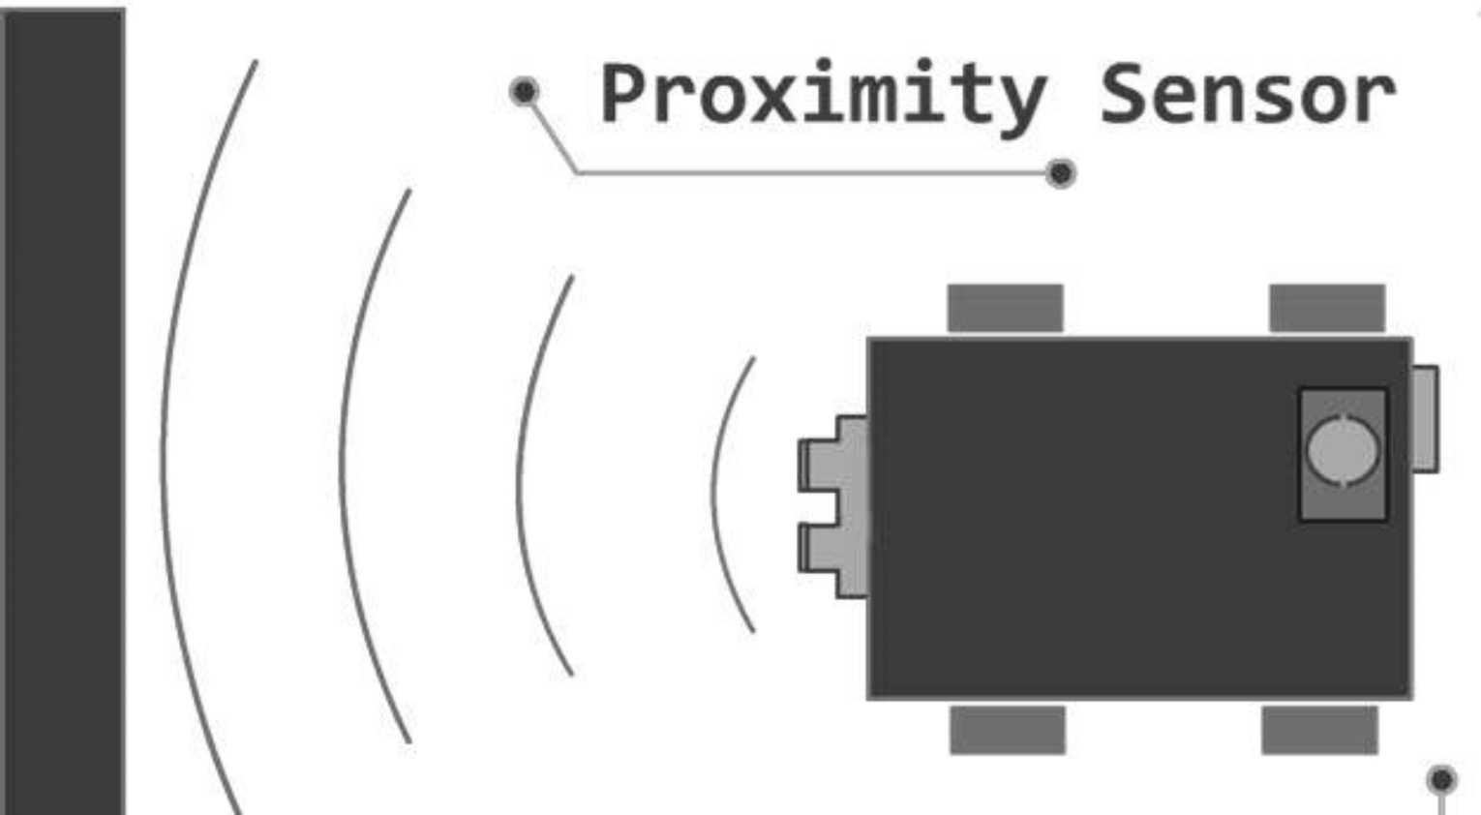
Proximity Sensors

Slide 12
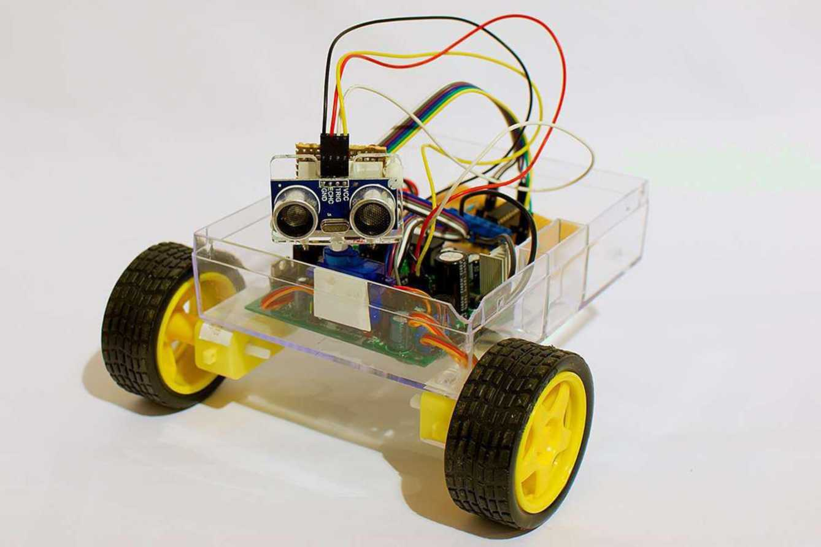
Obstacle Avoiding Robot

Slide 13
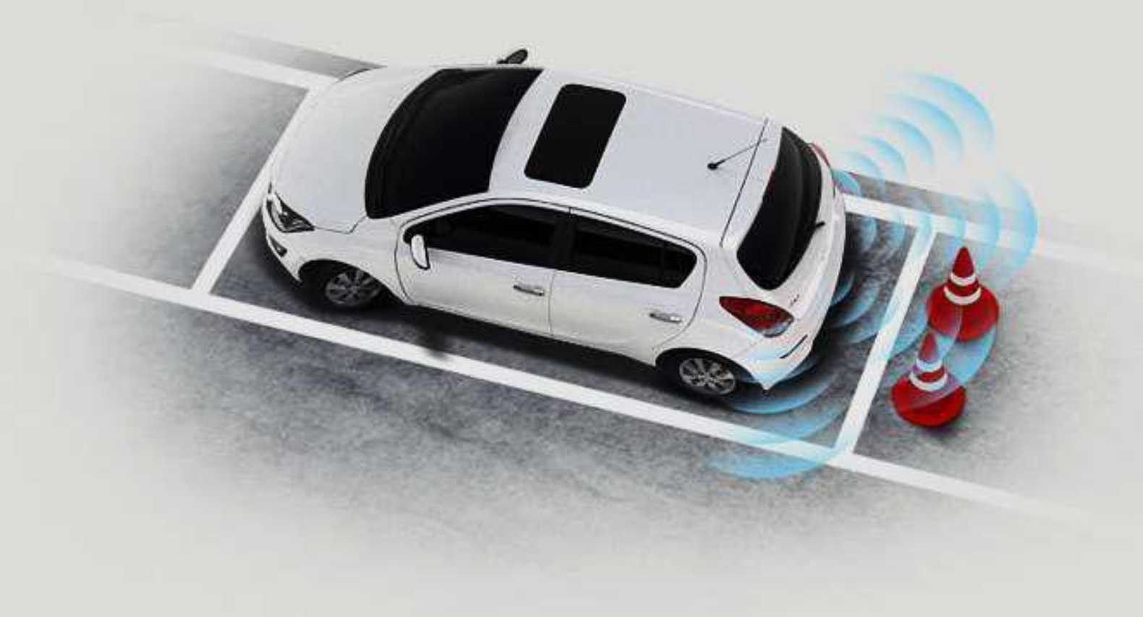
Advanced Parking Assistance

Slide 14
Circuit Diagram

Slide 15
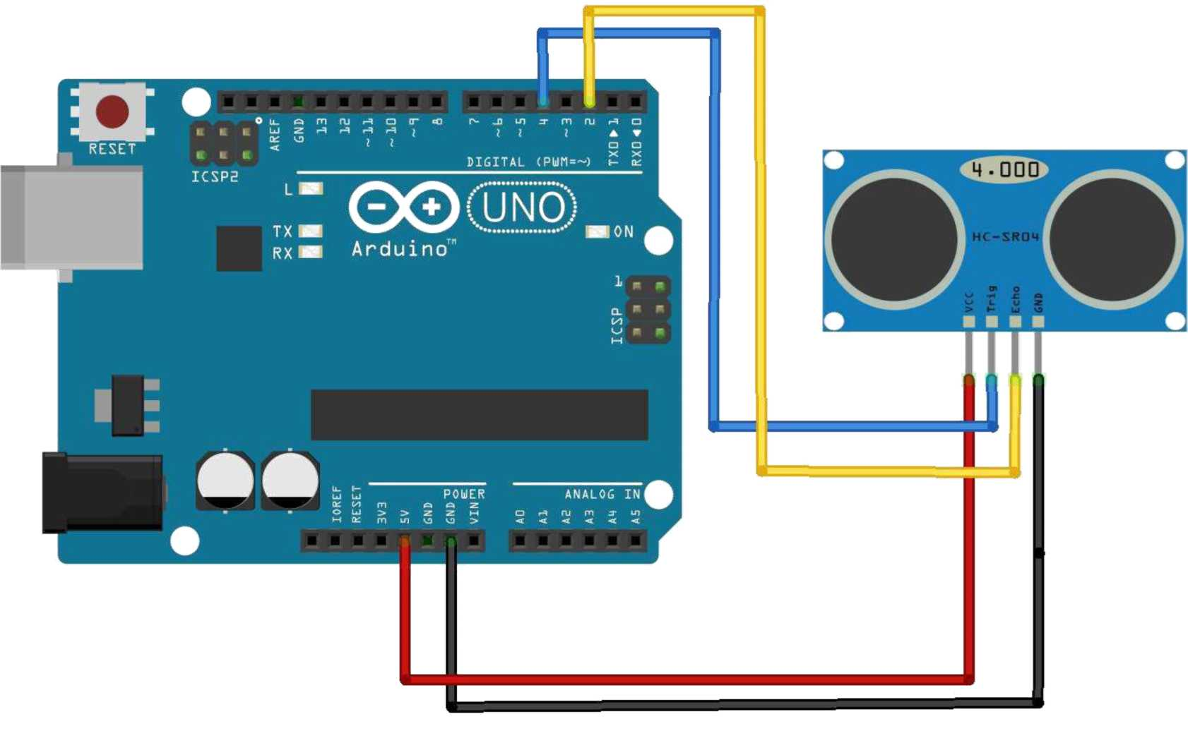

Slide 16
Arduino Code

Slide 17
#include <ESP8266WiFi.h>
#include <FirebaseArduino.h>
#define FIREBASE_HOST "ultrasonic-4082d.firebaseio.com"
#define FIREBASE_AUTH "i6PIeWKWLBmPuPT6VHftu8zoTIDeFNLdp83vKpgz"
#define WIFI_SSID "sonish"
#define WIFI_PASSWORD "123456789"

Slide 18
int trig=D1;
int Echo=D2;
int bulb[4]={D5,D6,D7,D8};
long duration;
int distance;
void setup() {
Serial.begin(115200);
pinMode(trig,OUTPUT);
pinMode(Echo,INPUT);
pinMode(D5,OUTPUT);
pinMode(D6,OUTPUT);
pinMode(D7,OUTPUT);
pinMode(D8,OUTPUT);

Slide 19
WiFi.begin(WIFI_SSID, WIFI_PASSWORD);
Serial.print("connecting");
while(WiFi.status()!=WL_CONNECTED){
Serial.print(".");
delay(500);
}
Serial.println();
Serial.print("connected: ");
Serial.println(WiFi.localIP());

Slide 20
Firebase.begin(FIREBASE_HOST, FIREBASE_AUTH);
Firebase.set("Height",50);
}
void firebasereconnect(){
Serial.println("Trying to reconnect");
Firebase.begin(FIREBASE_HOST, FIREBASE_AUTH);
}
int i; int height=50;
int temp=-1;
void loop() {
if (Firebase.failed()) {
Serial.print("setting number failed:");
Serial.println(Firebase.error());
firebasereconnect();
return;
}

Slide 21
int height= Firebase.getInt("Height");
Serial.print("height=");
Serial.println(height);
float arr[4];
percentage(height,arr);
digitalWrite(trig, HIGH);
delayMicroseconds(10);
digitalWrite(trig, LOW);
duration=pulseIn(Echo, HIGH);
distance=duration*0.034/2;
Serial.print("Distance :");

Slide 22
Serial.println(distance);
if(temp!=distance)
{
for(i=0;i<4;i++)
digitalWrite(bulb[i], LOW);
for(i=0;i<4;i++)
{
Serial.println(arr[i]);
if(distance>arr[i])
digitalWrite(bulb[i], HIGH);
temp=distance;
}
}
delay(1000);
}

Slide 23
void percentage(int a, float b[]){
float p[]={25.0,50.0,75.0,100.0};
for(int i=0;i<4;i++)
b[i]=(p[i]/100)*a;
}

